Slide 1


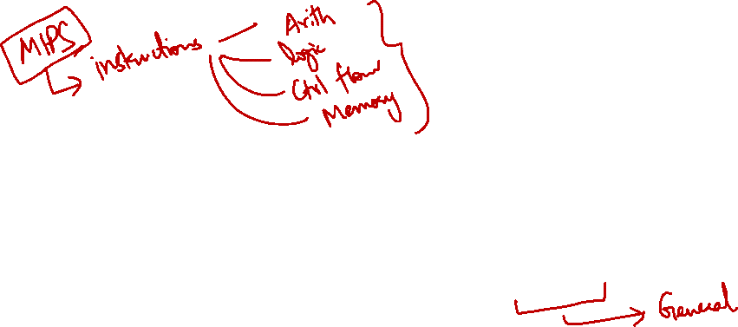
http://www.comp.nus.edu.sg/~cs2100/
Lecture #10
Instruction Set Architecture
(ISA)

Slide 2
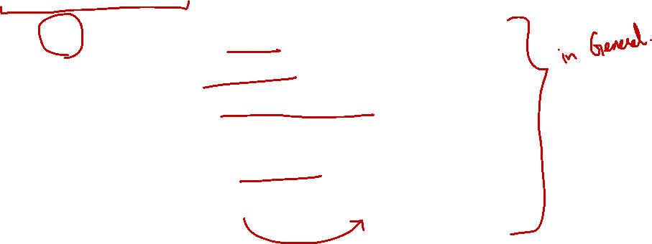
Lecture #10: Instruction Set Architecture
Overview
RISC vs CISC: The Famous Battle
The 5 Concepts in ISA Design
3.1 Concept #1: Data Storage
3.2 Concept #2: Memory and Addressing Mode
3.3 Concept #3: Operations in Instruction Set
3.4 Concept #4: Instruction Formats
3.5 Concept #5: Encoding the Instruction Set

Slide 3
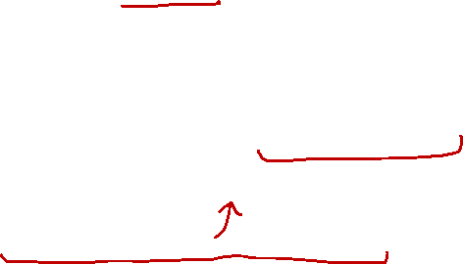
1. Overview
We have studied MIPS but it is only one example
There are many other assembly languages with different characteristics
This lecture gives a more general view on the design of Instruction Set Architecture (ISA)
Use your understanding of MIPS and explore other possibilities/alternatives

Slide 4
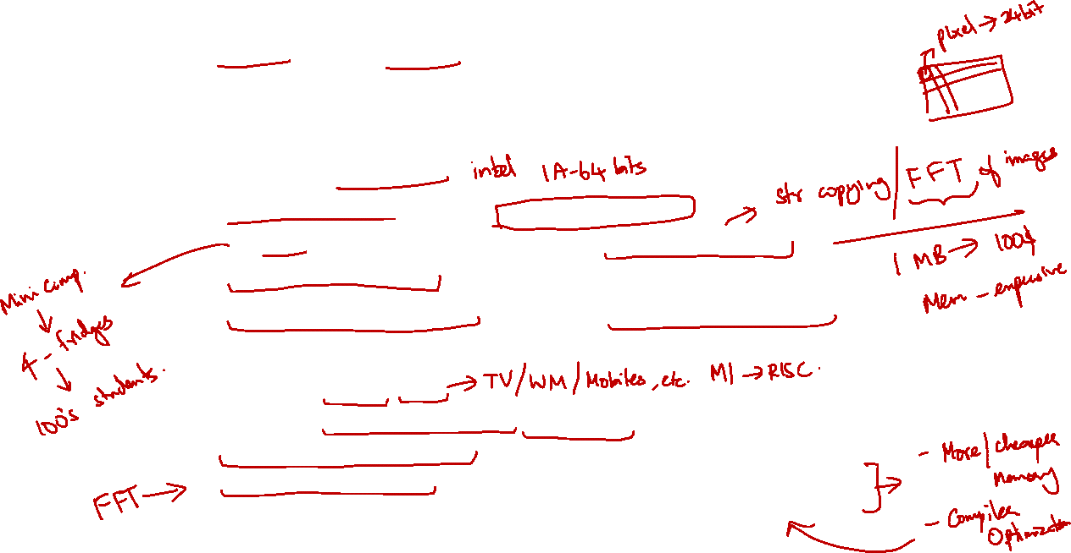
2. RISC vs CISC: The Famous Battle
Two major design philosophies for ISA:
Complex Instruction Set Computer (CISC)
Example: x86-32 (IA32)
Single instruction performs complex operation
VAX architecture had an instruction to multiply polynomials
Smaller program size as memory was premium
Complex implementation, no room for hardware optimization
Reduced Instruction Set Computer (RISC)
Example: MIPS, ARM
Keep the instruction set small and simple, makes it easier to build/optimise hardware
Burden on software to combine simpler operations to implement high-level language statements

Slide 5
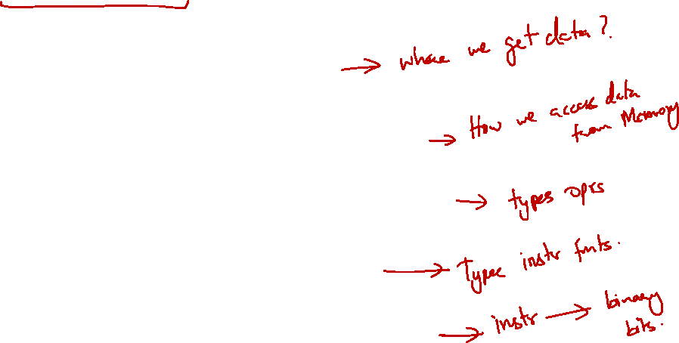
3. The 5 Concepts in ISA Design
1. Data Storage
2. Memory Addressing Modes
3. Operations in the Instruction Set
4. Instruction Formats
5. Encoding the Instruction Set

Slide 6
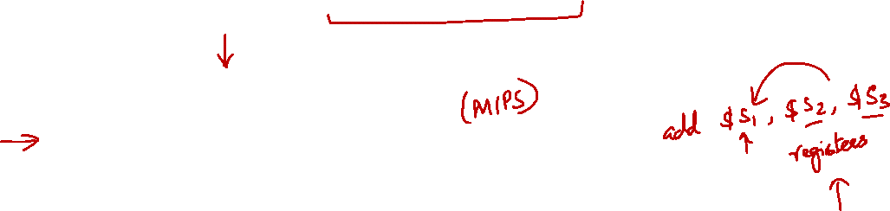
3.1 Concept #1: Data Storage
Storage Architecture
General Purpose Register Architecture
Concept #1: Data Storage
Concept #2: Memory Addressing Modes
Concept #3: Operations in the Instruction Set
Concept #4: Instruction Formats
Concept #5: Encoding the Instruction Set

Slide 7
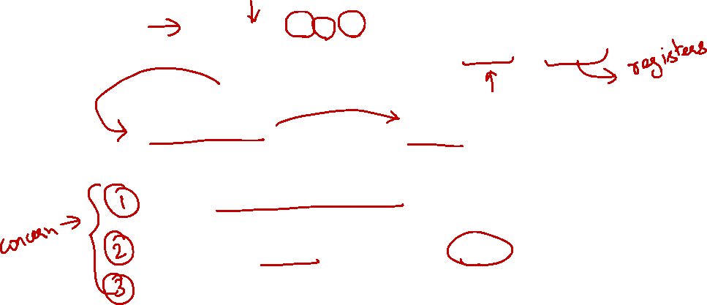
3.1 Storage Architecture: Definition
C = A + B
Operands may be implicit or explicit.
operands
operator
von Neumann Architecture:
Data (operands) are stored in memory
For a processor, storage architecture concerns with:
Where do we store the operands so that the computation can be performed?
Where do we store the computation result afterwards?
How do we specify the operands?
Major storage architectures … (next slide)

Slide 8
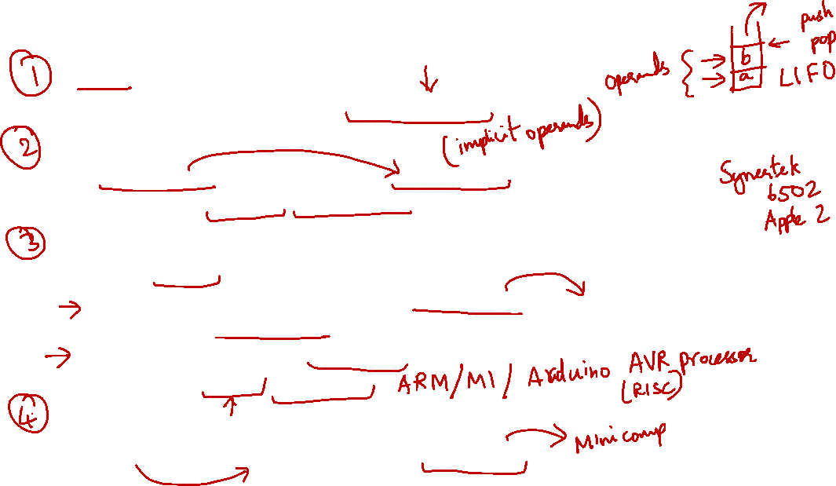
3.1 Storage Architecture: Common Design
Stack architecture:
Operands are implicitly on top of the stack.
Accumulator architecture:
One operand is implicitly in the accumulator (a special register). Examples: IBM 701, DEC PDP-8.
General-purpose register architecture:
Only explicit operands.
Register-memory architecture (one operand in memory). Examples: Motorola 68000, Intel 80386.
Register-register (or load-store) architecture.
Examples: MIPS, DEC Alpha.
Memory-memory architecture:
All operands in memory. Example: DEC VAX.

Slide 9
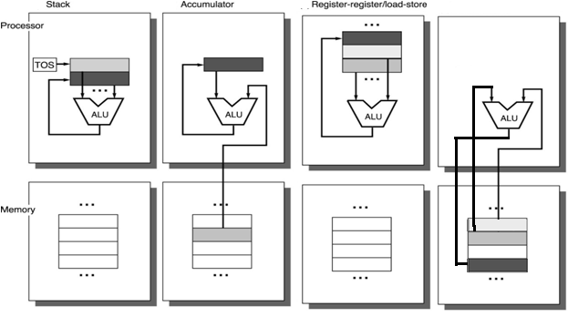
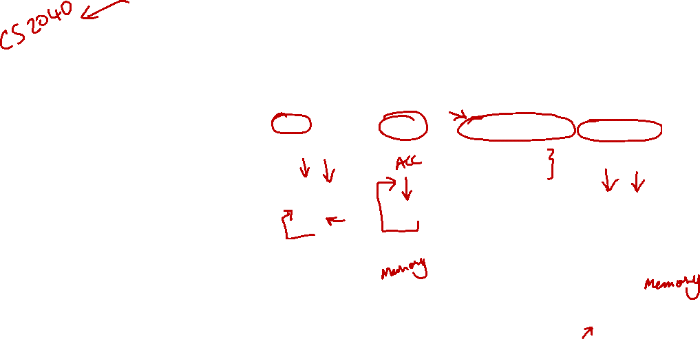
3.1 Storage Architecture: Example
Stack | Accumulator | Register (load-store) | Memory-Memory
Push A | Load A | Load R1,A | Add C, A, B
Push B | Add B | Load R2,B
Add | Store C | Add R3,R1,R2
Pop C |  | Store R3,C
Stack
Accumulator
Register-register/load-store
Memory-Memory
C = A+B

Slide 10
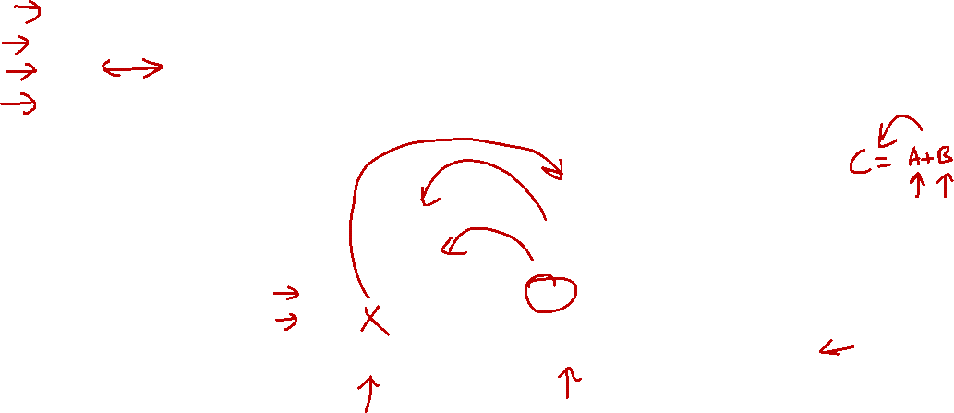
3.1 Storage Architecture: Animation
Stack | Accumulator | Register (load-store) | Memory-Memory
Push A | Load A | Load R1,A | Add C, A, B
Push B | Add B | Load R2,B
Add | Store C | Add R3,R1,R2
Pop C |  | Store R3,C
Push A
...
...
Push B
10
A
Add
20
B
Pop C
20
30
?
C
30
...
...
10
Stack
Memory
Variable Name
This is information remembered by the compiler.

Slide 11
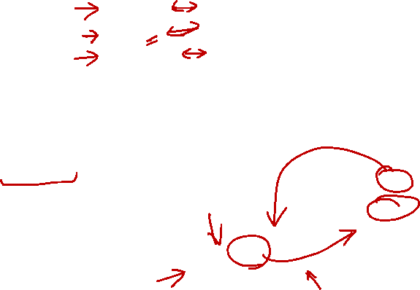
3.1 Storage Architecture: Animation
Stack | Accumulator | Register (load-store) | Memory-Memory
Push A | Load A | Load R1,A | Add C, A, B
Push B | Add B | Load R2,B
Add | Store C | Add R3,R1,R2
Pop C |  | Store R3,C
Load A
...
...
Add B
10
A
Store C
20
B
30
?
C
30
...
...
?
10
Accumulator
Memory
Variable Name
This is a special register!
This is information remembered by the compiler.

Slide 12
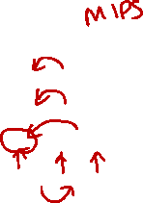
3.1 Storage Architecture: Animation
Stack | Accumulator | Register (load-store) | Memory-Memory
Push A | Load A | Load R1,A | Add C, A, B
Push B | Add B | Load R2,B
Add | Store C | Add R3,R1,R2
Pop C |  | Store R3,C
Load R1,A
...
...
...
...
Load R2,B
?
10
R1
10
A
Add R3,R1,R2
?
20
R2
20
B
Store R3,C
?
30
R3
30
?
C
...
...
...
...
Registers
Memory
Variable Name
These are general purpose registers
This is information remembered by the compiler.

Slide 13

3.1 Storage Architecture: Animation
Stack | Accumulator | Register (load-store) | Memory-Memory
Push A | Load A | Load R1,A | Add C, A, B
Push B | Add B | Load R2,B
Add | Store C | Add R3,R1,R2
Pop C |  | Store R3,C
Add C, A, B
...
...
10
A
20
B
30
?
C
...
...
Memory
Variable Name
This is information remembered by the compiler.

Slide 14
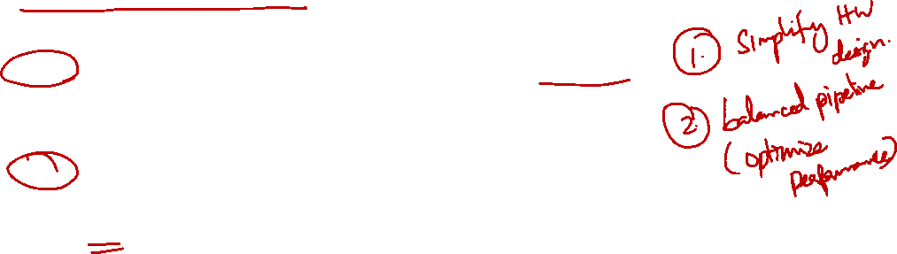
3.1 Storage Architecture: GPR Architecture
For modern processors:
General-Purpose Register (GPR) is the most common choice for storage design
RISC computers typically use Register-Register (Load/Store) design
E.g. MIPS, ARM
CISC computers use a mixture of Register-Register and Register-Memory
E.g. IA32

Slide 15

3.2 Concept #2: Memory Addressing Mode
Memory Locations and Addresses
Addressing Modes
Concept #1: Data Storage
Concept #2: Memory Addressing Modes
Concept #3: Operations in the Instruction Set
Concept #4: Instruction Formats
Concept #5: Encoding the Instruction Set

Slide 16
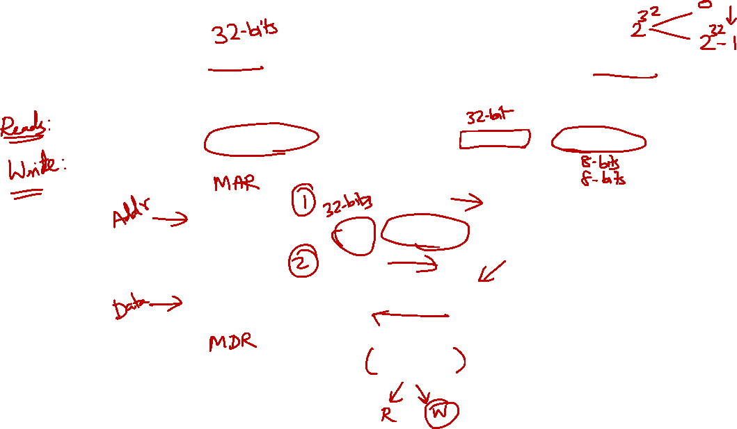
3.2 Memory Address and Content
Given k-bit address, the address space is of size 2^{k}
Each memory transfer consists of one word of n bits
Processor
Address
Memory
Up to 2^{k} addressable locations.
0
1
2
3
4
5
Memory Address Register
k-bit address bus
Memory Data Register
n-bit data bus
:
Control lines
(R/W, etc.)

Slide 17
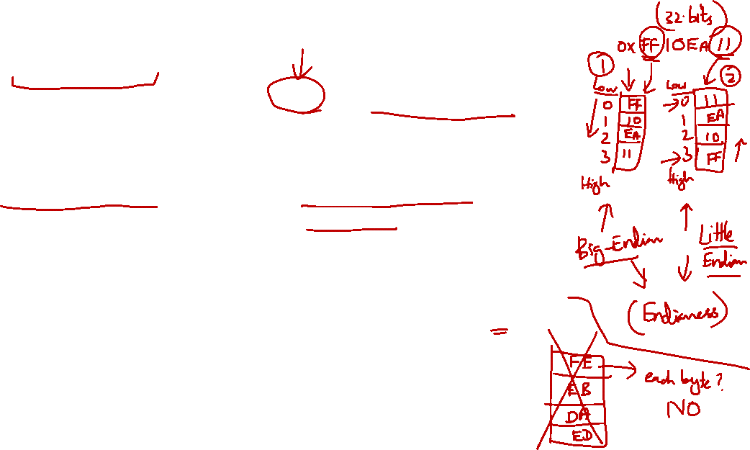
3.2 Memory Content: Endianness
Endianness:
The relative ordering of the bytes in a multiple-byte word stored in memory
Big-endian: | Little-endian:
Most significant byte stored in lowest address. Example: IBM 360/370, Motorola 68000, MIPS (Silicon Graphics), SPARC. | Least significant byte stored in lowest address. Example: Intel 80x86, DEC VAX, DEC Alpha.
Example: 0xDE AD BE EF Stored as: | Example: 0xDE AD BE EF Stored as:
0
DE
0
EF
1
AD
NOTE:
The endian-ness of MIPS is actually implementation specific.
1
BE
2
BE
2
AD
3
EF
3
DE

Slide 18
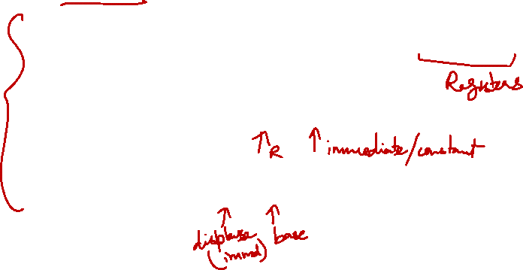
3.2 Addressing Modes
Addressing Mode:
Ways to specify an operand in an assembly language
In MIPS, there are only 3 addressing modes:
Register:
Operand is in a register (eg: add $t1, $t2, $t3)
Immediate:
Operand is specified in the instruction directly (eg: addi $t1, $t2, 98)
Displacement:
Operand is in memory with address calculated as Base + Offset (eg: lw $t1, 20($t2))

Slide 19
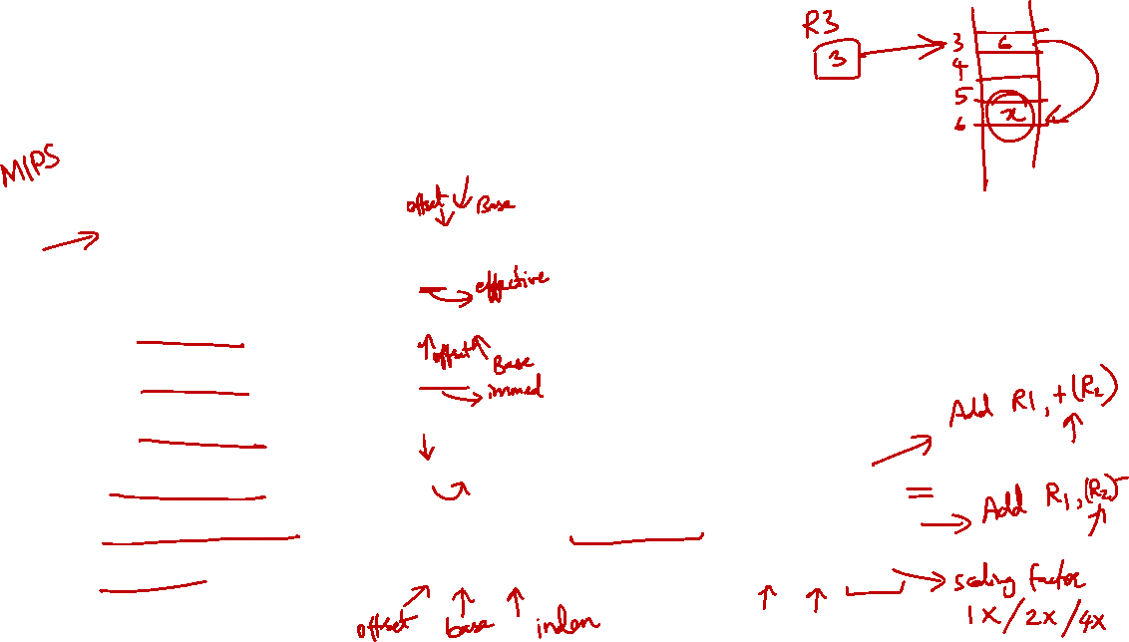
3.2 Addressing Modes: Others
Addressing mode
Example
Meaning
Register
Add R4,R3
R4 ← R4+R3
Immediate
Add R4,#3
R4 ← R4+3
Displacement
Add R4,100(R1)
R4 ← R4+Mem[100+R1]
Register indirect
Add R4,(R1)
R4 ← R4+Mem[R1]
Indexed / Base
Add R3,(R1+R2)
R3 ← R3+Mem[R1+R2]
Direct or absolute
Add R1,(1001)
R1 ← R1+Mem[1001]
Memory indirect
Add R1,@(R3)
R1 ← R1+Mem[Mem[R3]]
Auto-increment
Add R1,(R2)+
R1 ← R1+Mem[R2]; R2 ← R2+d
Auto-decrement
Add R1,–(R2)
R2 ← R2-d; R1 ← R1+Mem[R2]
Scaled
Add R1,100(R2)[R3]
R1 ← R1+Mem[100+R2+R3*d]

Slide 20
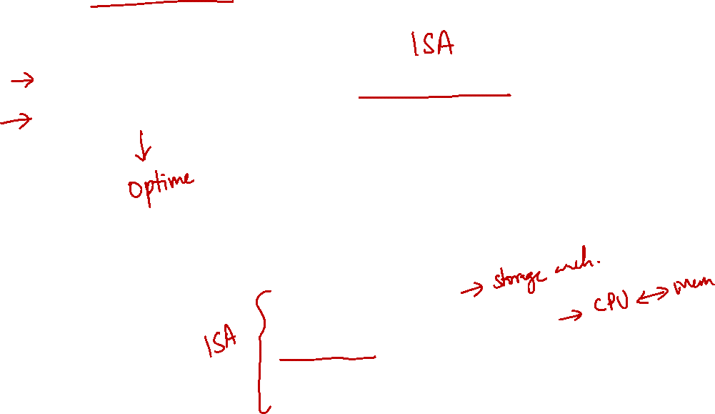
3.3 Concept #3: Operations in Instructions Set
Standard Operations in an Instruction Set
Frequently Used Instructions
Concept #1: Data Storage
Concept #2: Memory Addressing Modes
Concept #3: Operations in the Instruction Set
Concept #4: Instruction Formats
Concept #5: Encoding the Instruction Set

Slide 21
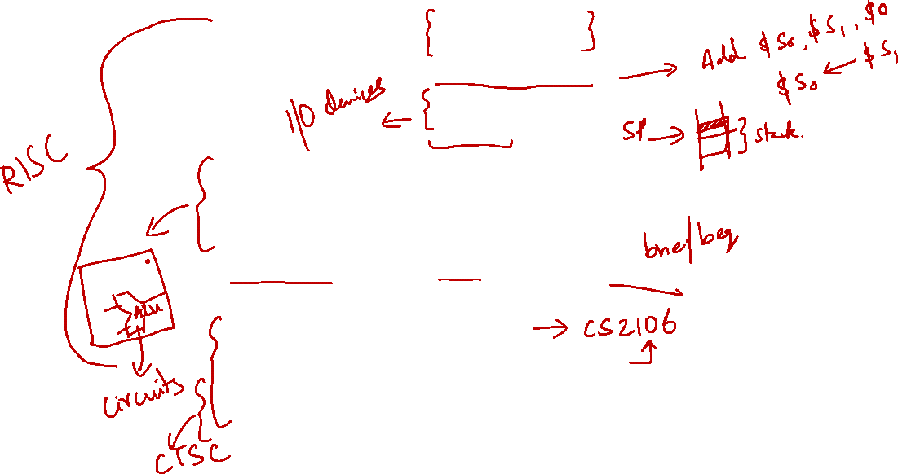
3.3 Standard Operations
Data Movement
load (from memory)
store (to memory)
memory-to-memory move
register-to-register move
input (from I/O device)
output (to I/O device)
push, pop (to/from stack)
Arithmetic
integer (binary + decimal) or FP
add, subtract, multiply, divide
Shift
shift left/right, rotate left/right
Logical
not, and, or, set, clear
Control flow
Jump (unconditional), Branch (conditional)
Subroutine Linkage
call, return
Interrupt
trap, return
Synchronisation
test & set (atomic r-m-w)
NOTE:
Synchronisation is used for multi-thread or multi-core operations.
Graphics now common in x86 (e.g., intel iris, etc).
String
search, move, compare
Graphics
pixel and vertex operations, compression/decompression

Slide 22
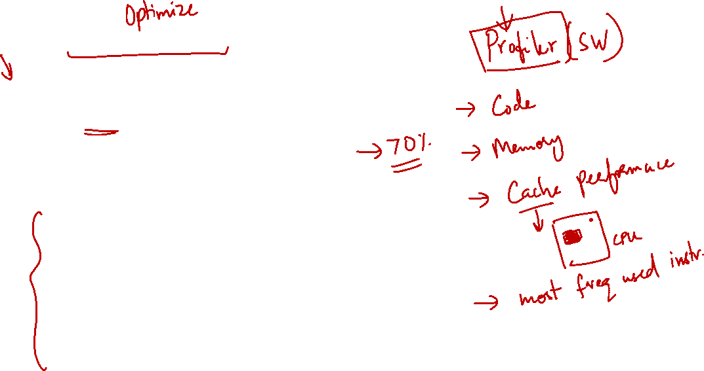
3.3 Frequently Used Instructions
Make these instructions fast!
Amdahl’s law – make the common cases fast!
Rank | Integer Instructions | Average %
1 | Load | 22%
2 | Conditional Branch | 20%
3 | Compare | 16%
4 | Store | 12%
5 | Add | 8%
6 | Bitwise AND | 6%
7 | Sub | 5%
8 | Move register to register | 4%
9 | Procedure call | 1%
10 | Return | 1%
 | Total | 96%
NOTE:
To briefly see the benefit, consider that we managed to decrease the time needed to compute the first 4 operations by 50% (i.e., time slashed by 2) at the expense that the rest are slower (e.g., time increase by 50%).
Then if the total time originally:
T = (0.7 * t) + (0.3 * t)
After the improvement, the total time will be:
T = (0.35 * t) + (0.45 t)
T = (0.80 * t)
Which is still an improvement.
In practice, typically there is no (or only slight) increase in the rest when we made improvement to some.

Slide 23
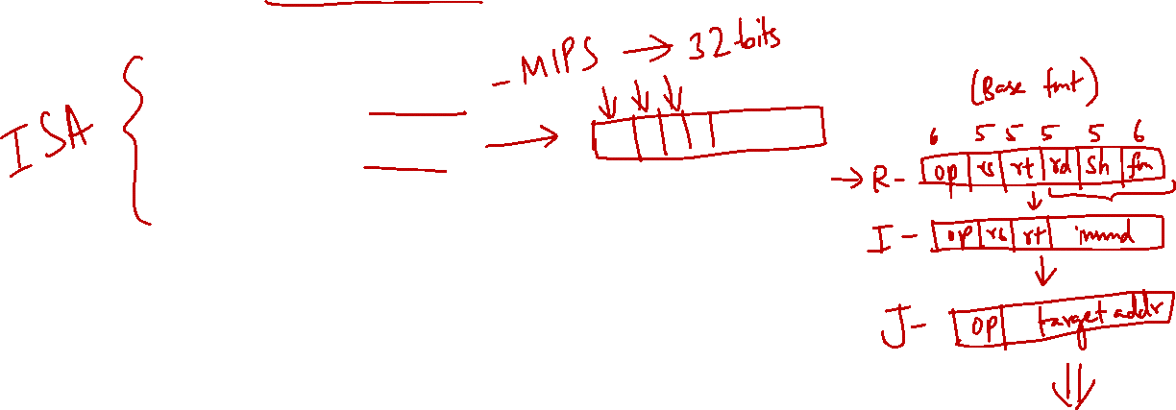
3.4 Concept #4: Instruction Formats
Instruction Length
Instruction Fields
Type and Size of Operands
Concept #1: Data Storage
Concept #2: Memory Addressing Modes
Concept #3: Operations in the Instruction Set
Concept #4: Instruction Formats
Concept #5: Encoding the Instruction Set

Slide 24
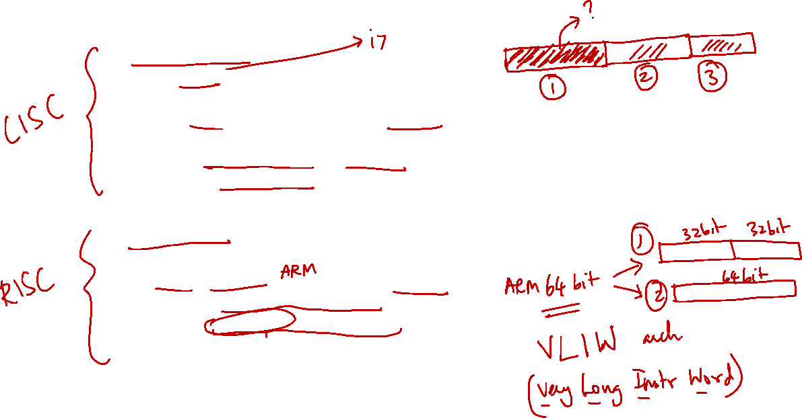
3.4 Instruction Length
Variable-length instructions.
Intel 80x86: Instructions vary from 1 to 17 bytes long.
Digital VAX: Instructions vary from 1 to 54 bytes long.
Require multi-step fetch and decode.
Allow for a more flexible (but complex) and compact instruction set.
Fixed-length instructions.
Used in most RISC (Reduced Instruction Set Computers)
MIPS, PowerPC: Instructions are 4 bytes long.
Allow for easy fetch and decode.
Simplify pipelining and parallelism.
Instruction bits are scarce.
Hybrid instructions: a mix of variable- and fixed-length instructions.

Slide 25
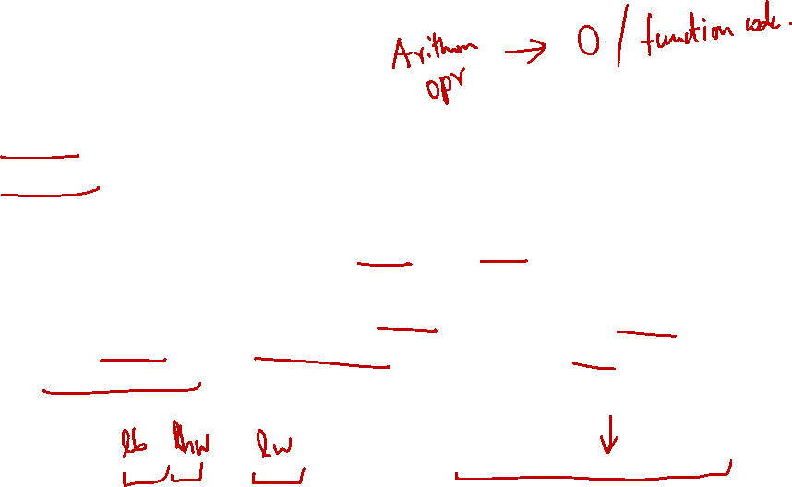
3.4 Instruction Fields
An instruction consists of
opcode: unique code to specify the desired operation
operands: zero or more additional information needed for the operation
The operation designates the type and size of the operands
Typical type and size: Character (8 bits), half-word (eg: 16 bits), word (eg: 32 bits), single-precision floating point (eg: 1 word), double-precision floating point (eg: 2 words).
Expectations from any new 32-bit architecture:
Support for 8-, 16- and 32-bit integer and 32-bit and 64-bit floating point operations. A 64-bit architecture would need to support 64-bit integers as well.

Slide 26
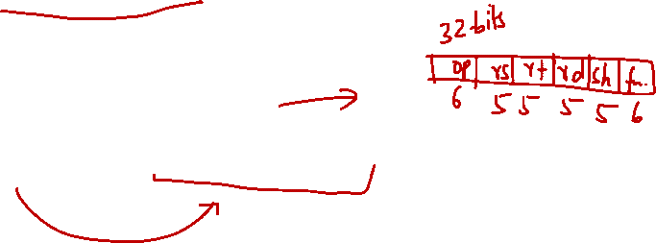
3.5 Concept #5: Encoding the Instruction Set
Instruction Encoding
Encoding for Fixed-Length Instructions
Concept #1: Data Storage
Concept #2: Memory Addressing Modes
Concept #3: Operations in the Instruction Set
Concept #4: Instruction Formats
Concept #5: Encoding the Instruction Set

Slide 27
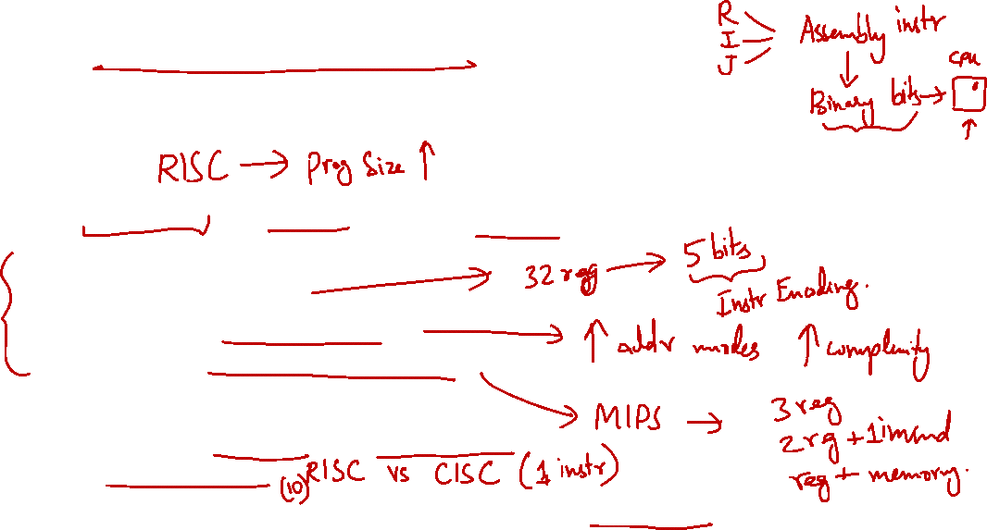
3.5 Instruction Encoding: Overview
How are instructions represented in binary format for execution by the processor?
Issues:
Code size, speed/performance, design complexity.
Things to be decided:
Number of registers
Number of addressing modes
Number of operands in an instruction
The different competing forces:
Have many registers and addressing modes
Reduce code size
Have instruction length that is easy to handle (fixed-length instructions are easier to handle)

Slide 28
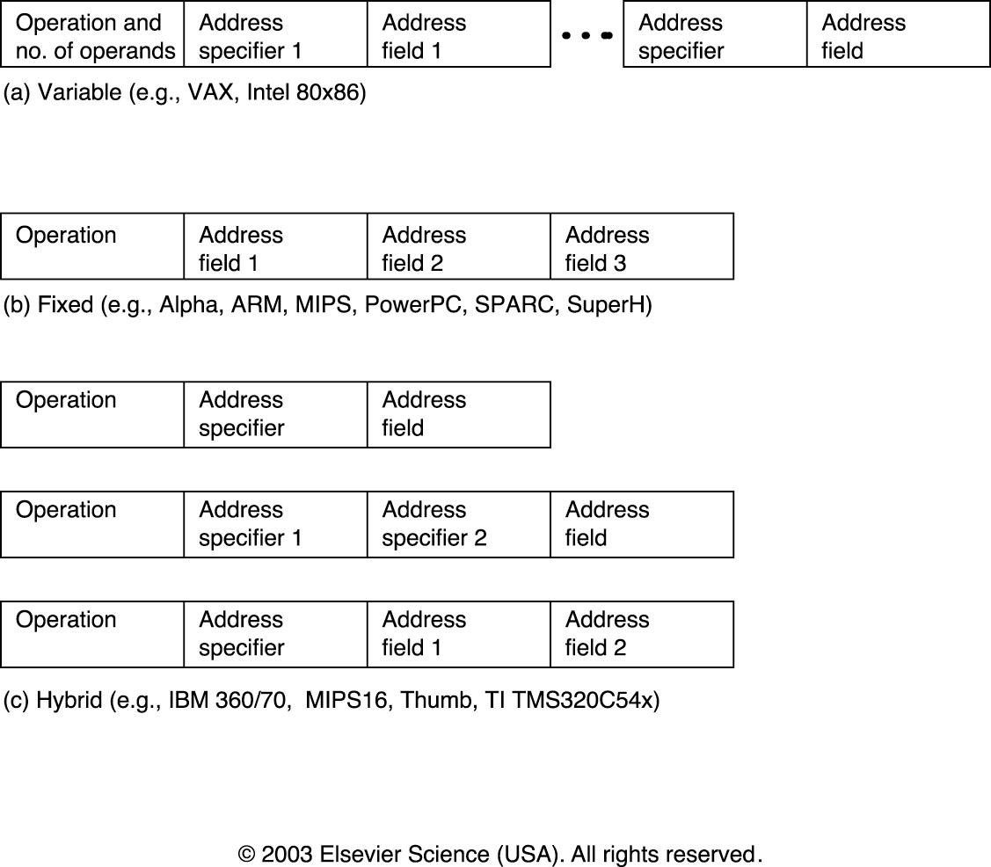
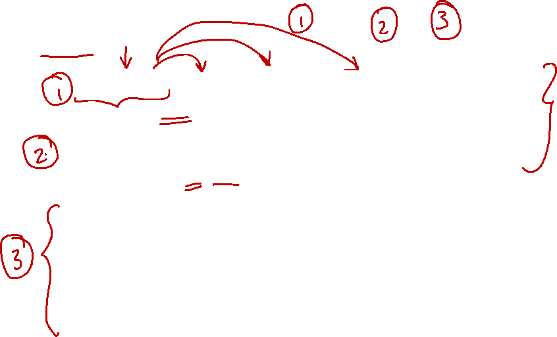
3.5 Encoding Choices
Three encoding choices: variable, fixed, hybrid.

Slide 29

3.5 Fixed Length Instructions: Encoding (1/4)
Fixed length instruction presents a much more interesting challenge:
Q: How to fit multiple sets of instruction types into same (limited) number of bits?
A: Work with the most constrained instruction types first
Expanding Opcode scheme:
The opcode has variable lengths for different instructions.
A good way to maximize the instruction bits.

Slide 30
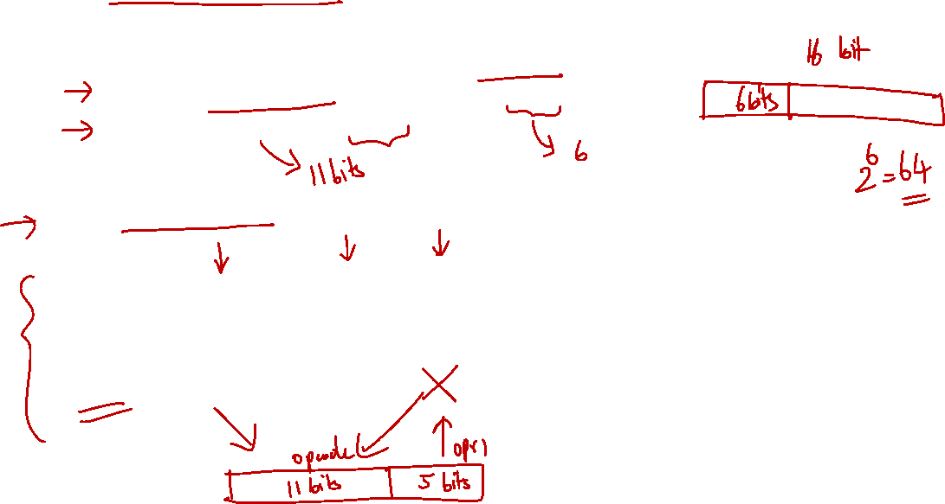
3.5 Fixed Length Instructions: Encoding (2/4)
Example:
16-bit fixed length instructions, with 2 types of instructions
Type-A: 2 operands, each operand is 5-bit
Type-B: 1 operand of 5-bit
First Attempt:
Fixed length Opcode
Problem:
Wasted bits in Type-B instructions
Maximum total number of instructions is 2⁶ or 64.
opcode
operand
operand
Type-A
6 bits
5 bits
5 bits
opcode
operand
unused
Type-B
6 bits
5 bits
5 bits
NOTE:
The opcode must be shared between type-A and type-B (e.g., 1 type-A and the rest are type-B; 1 type-B and the rest are type-A; or anything in between).
2⁶ is then simply ignore the unused bits.

Slide 31
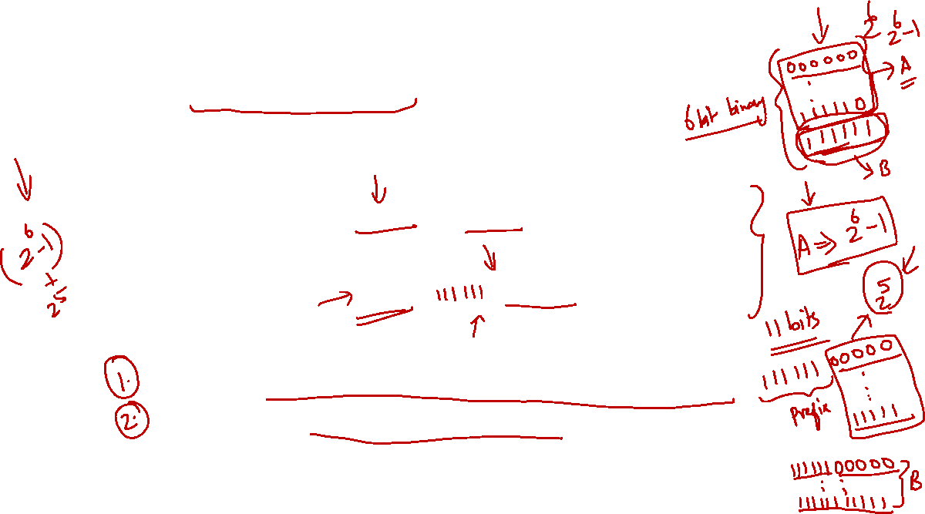
3.5 Fixed Length Instructions: Encoding (3/4)
Use expanding opcode scheme:
Extend the opcode for type-B instructions to 11 bits
➔ No wasted bits and result in a larger instruction set
opcode
operand
operand
Second Attempt:
Expanding Opcode
Type-A
6 bits
5 bits
5 bits
opcode
operand
Type-B
11 bits
5 bits
Questions:
How do we distinguish between Type-A and Type-B?
How many different instructions do we really have?
Possible Answers:
Think about MIPS, we simply set the opcode as all 0 for R-format but use the "extended opcode" called funct to distinguish.
There are different ways to compute the many different instructions depending on what to maximise and/or minimise.

Slide 32
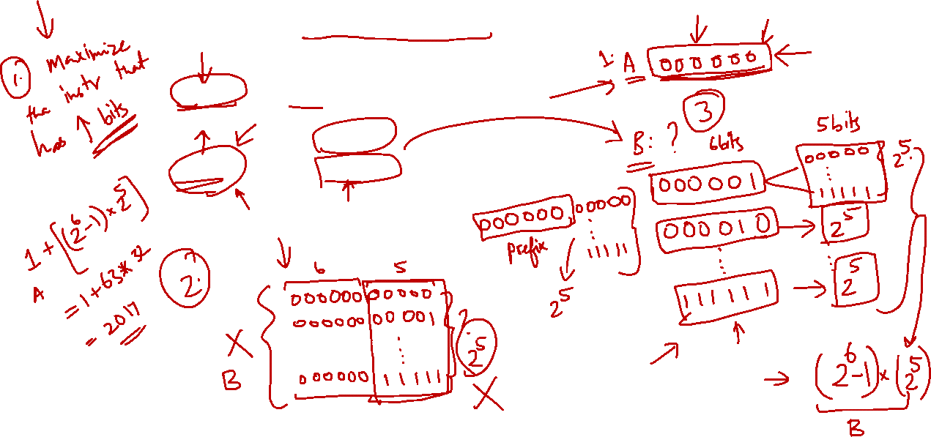
3.5 Fixed Length Instructions: Encoding (4/4)
What is the maximum number of instructions?
opcode
operand
operand
Answer:
1 + (2⁶ –1) × 2⁵
= 1 + 63×32
= 2017
Type-A
6 bits
5 bits
5 bits
opcode
operand
Type-B
11 bits
5 bits
Reasoning:
For every 6-bit prefix (front-part) given to Type-B, we get 2⁵ unique patterns, e.g. [111111]XXXXX
So, we should minimise Type-A instruction and give as many 6-bit prefixes as possible to Type-B
➔ 1 Type-A instruction, 2⁶ – 1 prefixes for Type-B

Slide 33
3.5 Extended Opcode Explanation
What is the maximum number of instructions?
opcode
operand
operand
Answer:
1 + (2⁶ –1) × 2⁵
= 1 + 63×32
= 2017
Type-A
6 bits
5 bits
5 bits
opcode
funct?
operand
Type-B
6 bits
5 bits
5 bits
Alternative #1: Minimise Type-B (use only one opcode)
opcode
funct?
operand
Type-B
000000
00000
to
11111
=
1 × 2⁵ = 32
NOTE:
This actually gives the minimum number of instruction (assuming no unused bits and both instructions exist). Can you see why?
opcode
operand
operand
+
Type-A
000001
to
111111
=
2⁶ - 1 (1 is used for type-B)
= 63
Total = 32 + 63 = 95

Slide 34
3.5 Extended Opcode Explanation
What is the maximum number of instructions?
opcode
operand
operand
Answer:
1 + (2⁶ –1) × 2⁵
= 1 + 63×32
= 2017
Type-A
6 bits
5 bits
5 bits
opcode
funct?
operand
Type-B
6 bits
5 bits
5 bits
Alternative #2: Minimise Type-A (use only one opcode)
opcode
funct?
operand
Type-B
000001
to
111111
00000
to
11111
=
(2⁶ - 1) × 2⁵
= 63 × 32 = 2016
opcode
operand
operand
+
Type-A
000000
=
1
NOTE:
Clearly, alternative #2 is larger. In fact, you can check that it will give you the maximum number of instructions.
Total = 2016 + 1 = 2017

Slide 35
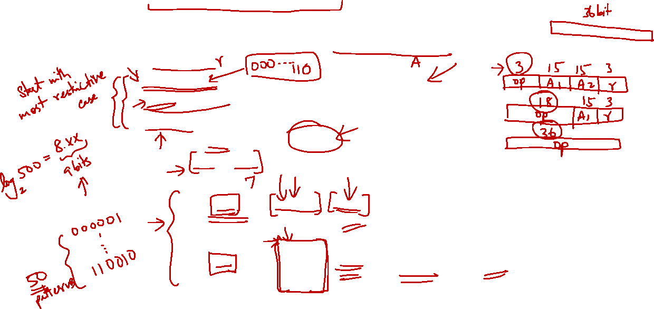
3.5 Expanding Opcode: Another Example
Design an expanding opcode for the following to be encoded in a 36-bit instruction format. An address takes up 15 bits and a register number 3 bits.
7 instructions with two addresses and one register number.
500 instructions with one address and one register number.
50 instructions with no address or register.
3 bits
15 bits
15 bits
3 bits
One possible answer:
000 → 110
address
address
register
opcode
111
000000 + 9 bits
address
register
opcode
000001
111
:
+ 9 0s
unused
unused
110010
opcode

Slide 36
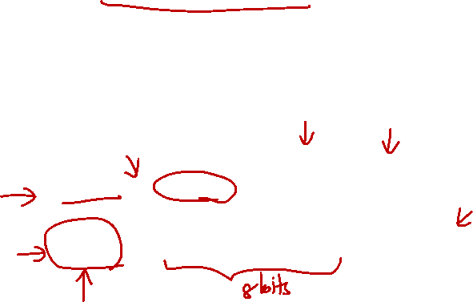
Past Midterm/Exam Questions (1/2)
A certain machine has 12-bit instructions and 4-bit addresses. Some instructions have one address and others have two. Both types of instructions exist in the machine.
What is the maximum number of instructions with one address?
15
16
240
256
None of the above
opcode
address
address
Type-A
4 bits
4 bits
4 bits
opcode
funct?
address
Type-B
4 bits
4 bits
4 bits
NOTE:
What is the maximum number of type-B instruction. We are only interested in type-B and not the total.
Use the same idea: minimise type-A instruction.
This gives us the following computation:
(2⁴ - 1) × (2⁴) = 15 × 16 = 240
Please discuss in forum.
Answer: (c)


Slide 37
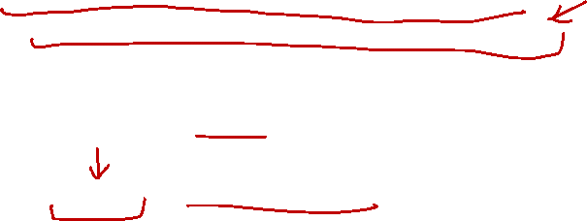
Past Midterm/Exam Questions (2/2)
A certain machine has 12-bit instructions and 4-bit addresses. Some instructions have one address and others have two. Both types of instructions exist in the machine.
What is the minimum total number of instructions, assuming the encoding space is completely utilised (that is, no more instructions can be accommodated)?
31
32
48
256
None of the above
opcode
address
address
Type-A
4 bits
4 bits
4 bits
opcode
funct?
address
Type-B
4 bits
4 bits
4 bits
NOTE:
We use the alternative #1 to minimise. This gives us the following computation:
(2⁴ - 1) + (1 × 2⁴) = 15 + 16 = 31
Please discuss in forum.
Answer: (a)


Slide 38
Reading
Instructions: Language of the Computer
COD Chapter 2, pg 46-53, 58-71. (3rd edition)
COD Chapter 2, pg 74-81, 86-87, 94-104. (4th edition)

Slide 39
End of File

